Slide 1
Input/Output (I/O) Ports and Interfacing

Slide 2
Basic Concepts in I/O Interfacing and PIC18 I/O Ports (1 of 2)
 I/O devices (or peripherals) such as LEDs and keyboards are essential components of the microprocessor-based or microcontroller-based systems.
 Classified into two groups
 input devices
 output devices

Slide 3
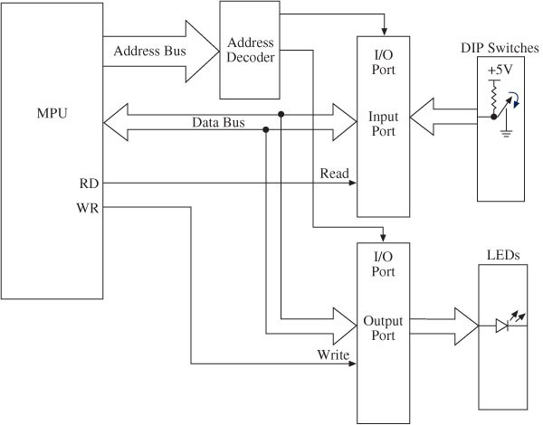
Block Diagram of I/O Interfacing
Buffer
Access one port at a time 8-bit registers
I/O ports are associated with a SFR Each port is associated with 3 registers:
PORT / LAT / TRIS
Latch

Slide 4
I/O Ports:
Interfacing and Addressing
 To read (receive) binary data from an input peripheral
 MPU places the address of an input port on the address bus, enables the input port by asserting the RD signal, and reads data using the data bus.
 To write (send) binary data to an output peripheral
 MPU places the address of an output port on the address bus, places data on data bus, and asserts the WR signal to enable the output port.
 Remember:
 Writing to the port
 When the MPU sends out or transfers data to an output port
 Reading from the port
 When the MPU receives data from an input port

Slide 5
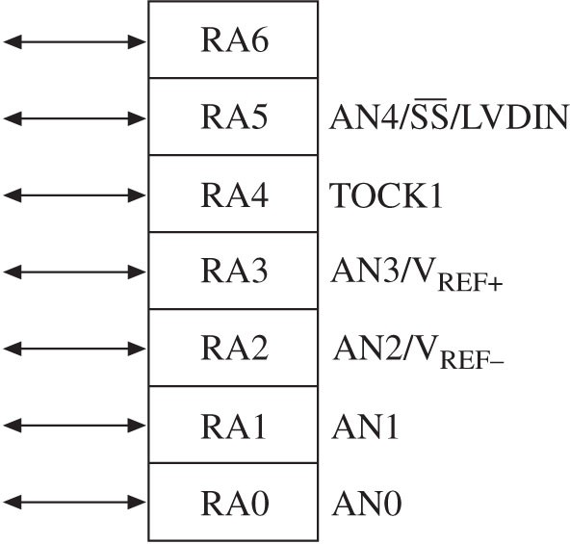
PIC18F452/4520 I/O Ports (1 of 5)
 MCU includes five I/O ports
 PORTA, PORTB, PORTC, PORTD, and PORTE
 Ports are multiplexed meaning they can be set up by writing instructions to perform various functions
PORTA: Example of Multiple Functions
 Digital I/O: RA6-RA0
 Analog Input: AN0-AN4

V _{REF}+ : A/D Reference Plus
Voltage
 V _{REF}- : A/D Reference
 Minus Voltage
 TOCK1: Timer0 Ext. Clock
 SS: SPI Slave Select Input
 LVDIN: Low voltage Detect Input

Slide 6
PIC18F452/4520 I/O Ports (2 of 5)
 Each I/O port is associated with the special functions registers (SFRs) to setup various functions.
 Can be set up as entire ports or each pin can be set up.
 PORT: This register functions as a latch or a buffer determined by the logic levels written into the associated TRIS register.
 TRIS: This is a data direction register. Writing logic 0 to a pin sets up the pin as an output pin, and logic 1 sets up the pin as an input pin.
 LAT: This determines if port is bidirectional .

Slide 7
PIC18F452/4520 I/O Ports (3 of 5)
 Internal block diagram of PORTB includes:
 Three internal D flip-flops (latches)
 Data latch to output data
 TRIS latch to setup data direction
 Input latch for input data

Slide 8
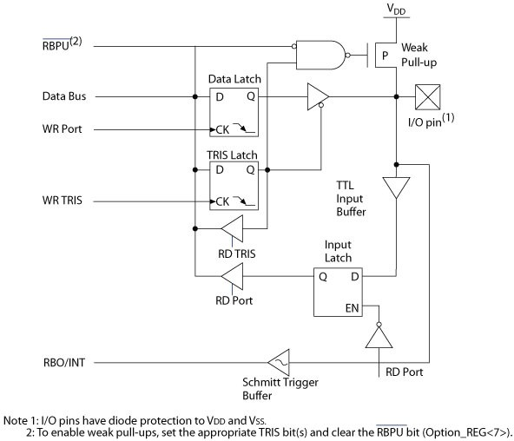
PIC18F452/4520 I/O Ports (4 of 5)
 PORTB Internal Block Diagram
Pull-up
Three internal D flip-flops (latches):
Data latch to output data TRIS latch to setup data
direction
Input latch for input data
A
Q- TRIS: 0 →→ A is enabled
Q- TRIS: 1 →→ A is disabled

Slide 9
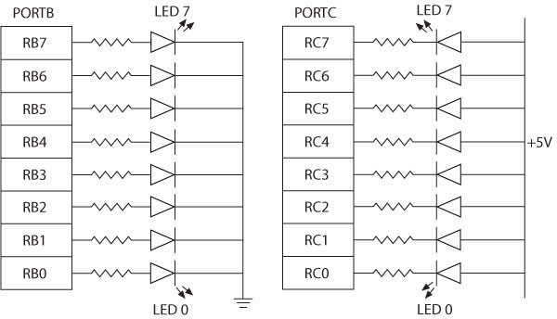
Interfacing Output Peripherals (1 of 2)
 Commonly used output peripherals in embedded systems are
 LEDs, seven-segment LEDs, and LCDs; the simplest is LED
 Two ways of connecting LEDs to I/O ports:
 LED cathodes are grounded and logic 1 from the I/O port turns on the LEDs - The current is supplied by the I/O port called current sourcing.
 LED anodes are connected to the power supply and logic 0 from the I/ O port turns on the LEDs - The current is received by the chip called current sinking.
Common Cathode
Active high
Common Anode
Active low

Slide 10
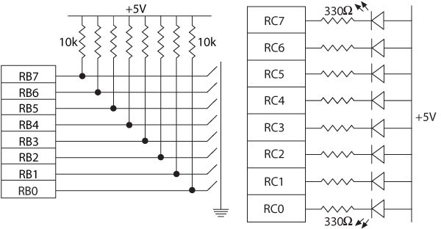
Interfacing Dip Switches and Interfacing LEDs

Slide 11
Driving an LED
 Transistor inverter acting as the driver
 Assume LED requires 3.5 Volts and 20 mA
 2N2222 is Current Amplifier →→ generates collector current
(multiplies base-current)
 In this case the current gain is 100!
 Note Vbe=0.7
+12V
8.5 V
8.5 V
R1 430
20 mA
D1
3.5 V
4.3-0.7
3.6 V
R2
20 mA
4.3 V minimum
3.0 mA maximum
Q1
2N2222
18K
Port Pin
0.2 mA
3.6 V
0.2 mA
3.6/18000

Slide 12
Driving a RELAY & SOLENOID
 Controlling appliances
 Driving solenoid
+12V
LS1 RELAY
SPDT
DS1
+5V
3
5
25 Watt Lamp
Solenoid
4
1
2
1
2
R1
Q1 2N2222A
D1
R1
Q1 MPSA13
D1
RB0
RB0
5.6K
5.6K

Slide 13
Example: Reading from an I/O Port
 The instruction: MOVF PORTB, W reads from PORTB.
 To execute the instruction, the MPU does the following:
 Reads the instruction from memory
 Places the address of PORTB (F81H) on the address bus of data memory
 Selects PORTB
 Asserts the RD signal and enables PORTB
 Reads logic levels (1/0) of the switches and places on the data bus
 Saves the reading in the WREG

Slide 14
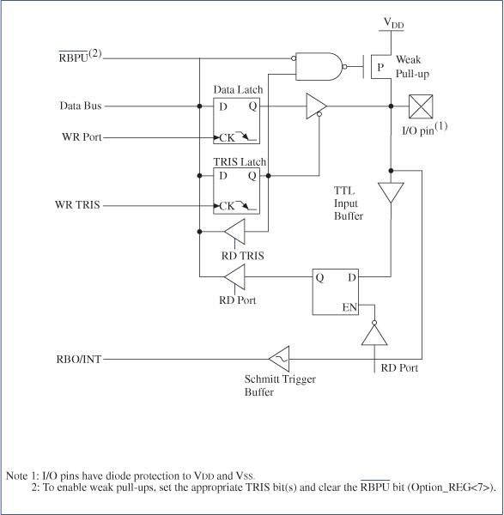
Internal Pull-Up Resistor (1 of 2)
 The pull-up resistors are connected externally.
However, PORTB can provide equivalent resistors internally through initialization.
 Turning off the internal FET is equivalent to providing a pull-up resistor.

Slide 15
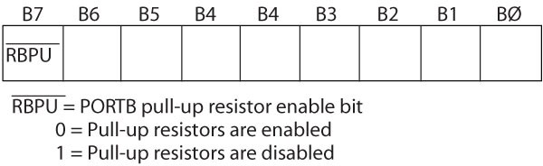
Internal Pull-Up Resistor (2 of 2)
 Bit7 (RBPU) in the INTCON2 register enables or disables the pull-up resistor
 Instruction to Enable Pull Up Resistors: BCF INTCON2 7, 0
C Code: INTCON2bit.RBPU = 0 // pull-ups on

Slide 16
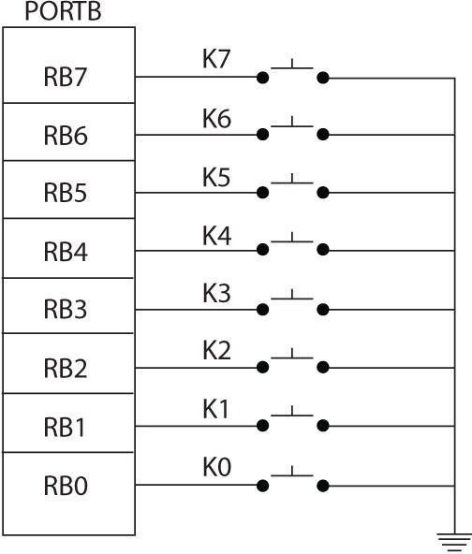
Illustration:
Interfacing Push-Button Keys (1 of 6)
 Problem statement
 A bank of push-button keys are connected as inputs to PORTB.
 The pull-up resistors are internal to PORTB.
 Write a program to recognize a key pressed, debounce the key, and identify its location in the key bank with numbers from 0 to 7.

Slide 17
Data Converters

Slide 18
Data Converters:
Basic Concepts
□□ Analog signals are continuous, with infinite values in a given range.
□□ Digital signals have discrete values such as on/off or 0/1.
□□ Limitations of analog signals
 Analog signals pick up noise as they are being amplified.
 Analog signals are difficult to store.
 Analog systems are more expensive in relation to digital systems.

Slide 19
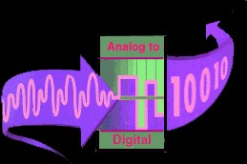
Data Converters: Basic Concepts
□□ Advantages of digital systems (signals)
 Noise can be reduced by converting analog signals in 0s and 1s.
 Binary signals of 0s/1s can be easily stored in memory.
 Technology for fabricating digital systems has become so advanced that they can be produced at low cost.
□□ The major limitation of a digital system is how accurately it represents the analog signals after conversion.

Slide 20
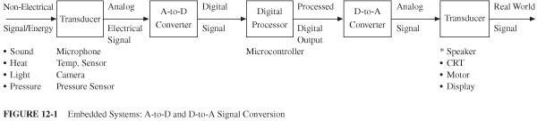
Embedded System
□□ A typical system that converts signals from analog to digital and back to analog includes:
 A transducer that converts non-electrical signals into electrical signals
 An A/D converter that converts analog signals into digital signals
 A digital processor that processes digital data (signals)
 A D/A converter that converts digital signals into equivalent analog signals
 A transducer that converts electrical signals into real life non-electrical signals (sound, pressure, and video)
So, how does A/D Converter works?

Slide 21
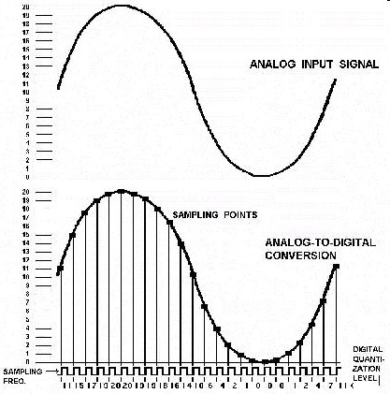
A/D Converter
□□ In order to change an analog signal to digital, the input analog signal is sampled at a high rate of speed.
□□ The amplitude at each of those sampled moments is converted into a number equivalent – this is called quantization.
□□ These numbers are simply the combinations of the 0s and 1s used in computer language – this called encoding.
http://www.cybercollege.com/tvp008.htm

Slide 22
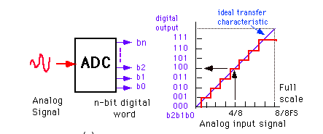
Analog-to-Digital
7/8
□□ A simple hypothetical A/D converter circuit with one analog input signal and three digital output lines with eight possible binary combinations: 000 to 111
 Shows the graph of digital output for FS V analog input
□□ The following points can be summarized in the above process:
 Maximum value this quantization process reaches is 7/8 V for a 1 V analog signal; includes 1/8 V an inherent error
 1/8 V (an inherent error) is also equal to the value of the Least Significant Bit (LSB) = 001.
 Resolution of a converter is defined in terms of the number of discrete values it can produce; also expressed in the number of bits used for conversion or as 1/2^{n} where n =number of bits
 The value of the most significant bit (MSB) -100- is equal to ½ the voltage of the full-scale value of 1 V.
 The value of the largest digital number 111 is equal to full-scale value minus the value of the LSB.
 The quantization error can be reduced or the resolution can be improved by increasing the number of bits used for the conversion

Slide 23
PIC18F4520 Analog-to-Digital (A/D) Converter Module (1 of 3)
□□ The PIC184520 microcontroller includes:
 10-bit A/D converter
 13 channels AN0 – AN12
 Three control registers
□□ ADCON0, ADCON1, and ADCON2

Slide 24
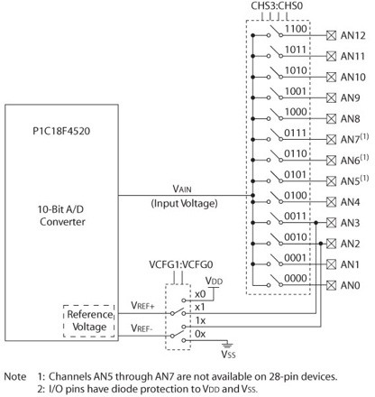
PIC18F4520 Analog-to-Digital (A/D) Converter Module (2 of 3)
ADCON0
□□ ADCON0, ADCON1, and ADCON2
□□ ADRESH and ADRESL
ADRESH/L
16-bit
VCFG0
VCFG1

Slide 25
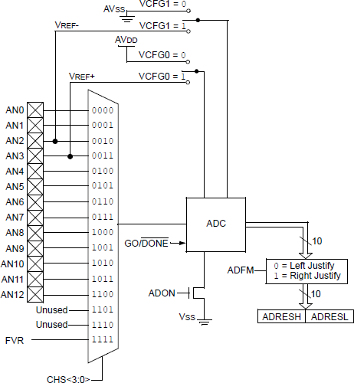
PIC18F2XK20/4XK20 Analog-to-
Digital (A/D) Converter Module (2 of 3)
VCFG1
□□ ADCON0, ADCON1, and ADCON2
□□ ADRESH and ADRESL
VCFG0 ADCON1
ADCON0
ADCON2
1.2V Fixed Voltage Reference (FVR)
Register: CM2CON1
ADCON0 CHSx
ADRESH/L
16-bit

Slide 26
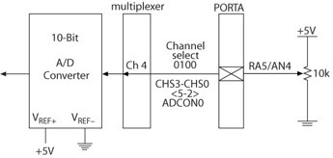
PIC18F4520 Analog-to-Digital (A/D) Converter Module (3 of 3)
□□ Three control registers are used to:
 Set up the I/O pins for analog signals from ports A, B, and E that are used as inputs for A/D conversion. RA5
 Select a channel: AN4
 Set up pins RA2 and RA3 to connect external V_{REF} + and V_{REF} - if specified in the control register ADCON1.
 Select an oscillator frequency divider through the control register ADCON2.
 Select an acquisition time through the control register ADCON2.
If the input is 0-1V→→ Vin=[0-1]: Option1: Vref+ & Vref- →→ 1V & GND
Option 2: Shift Vin to Vin’= Vin=[0-Vcc] and then Vref+ & Vref- →→ Vcc & GND

Slide 27
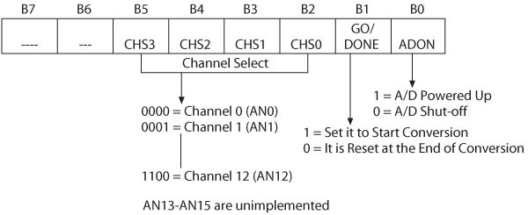
A/D Control Register0 (ADCON0)
□□ Primary function of the ADCON0 register:
 Select a channel for input analog signal
 Start a conversion
 Indicate the end of the conversion
□□ Bit1 is set to start the conversion, and at the end of the conversion this bit is reset.

Slide 28
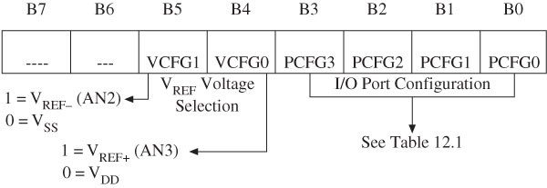
A to D Control Register1 (ADCON1)
□□ ADCON1 is primarily used to set up the I/O pins either for analog signal or for digital signals (see Table 12.2) and select V_{REF} voltages (see Table 12.1).

Slide 29

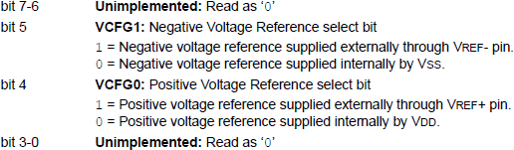
A to D Control Register1 (ADCON1)
□□ ADCON1 is primarily used to set up the I/O pins either for analog signal or for digital signals
Refer to ANSEL and ANSELH Registers to setup inputs as analog ports

Slide 30
A to D Control Register1 (ADCON1)
□□ ADCON1 is primarily used to set up the I/O pins either for analog signal or for digital signals
Refer to ANSEL and ANSELH Registers to setup inputs as analog ports

Slide 31
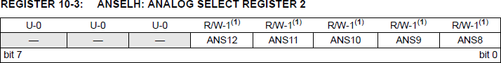
Selecting the Analog Port
ANSEL
PIC18F2XK20 devices: RE2
RE1 RE0
RA5 RS3 RA2 RA1
RA0 (bit 0)
RB6 RB4 RB1 RB3
RB0 (bit 0)

Slide 32
A to D Control Register2 (ADCON2)
(1 of 2)
□□ Used to:
 Select an acquisition time and clock frequency
 Right or left justify output reading
□□ The output reading, after a conversion, is stored in the 16-bit register ADRESH and ADRESL. However, this is a 10-bit A/D converter leaving six bit positions unused.
□□ Bit7 ADFM enables the user either to right justify or left justify the 16-bit reading leaving the unused positions as 0s.

Slide 33
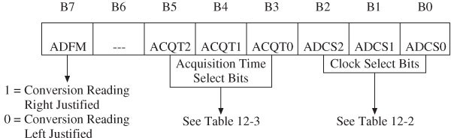
A to D Control Register2 (ADCON2)
(2 of 2)

Slide 34
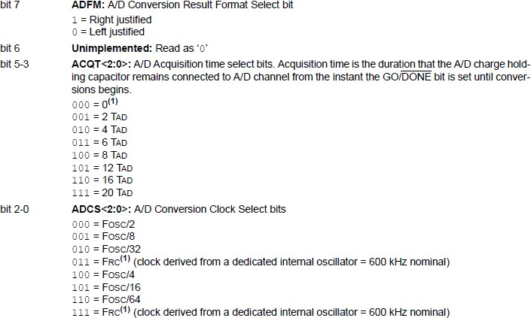
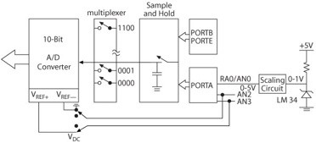
A to D Control Register2 (ADCON2)
(2 of 2)
TAD
TACQ
Note this is in Hz

Slide 35
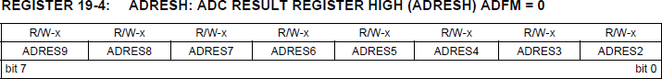
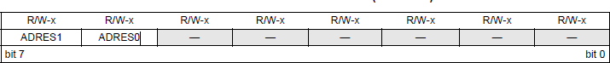
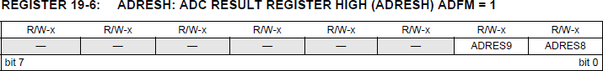
Reading the OUTPUT Results
Left ustificatio
J
n
Right ustificatio
J
n

Slide 36
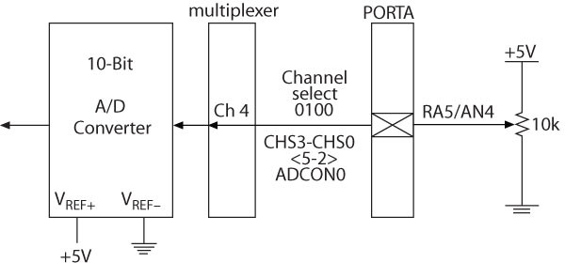
Example 12.3
□□ Interfacing a 10 k Pot
Refer to : ANSEL

Slide 37
Example
□□ Assumptions
 Use RE0 on the demo board.
 Use external oscillator
 Assuming conversion time (TAD) is 4 usec, what is the clock frequency requirement (ADCON2)
 Assume acquisition time is 48 usec. What will be the acquisition time setting?
 Write the program
□□ Set up the following registers properly:
 ADCON0, ADCON1, ADCON2.

Slide 38
Introduction UART

Slide 39
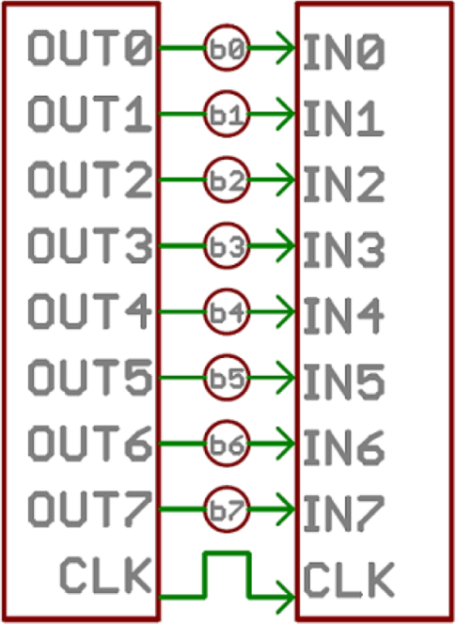
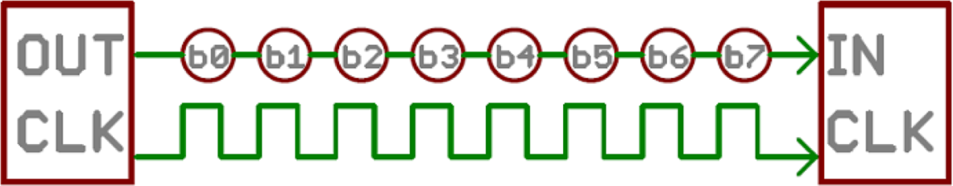
Communication Protocols
Parallel Vs. Serial
Parallel: Faster / More expensive
Serial: Cheaper / slower

Slide 40
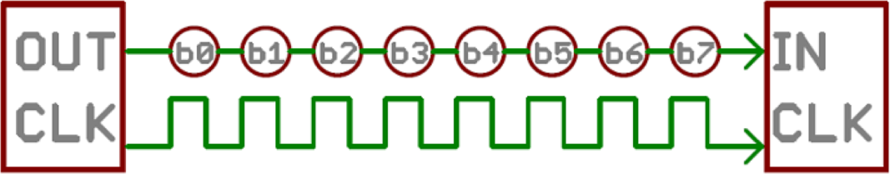
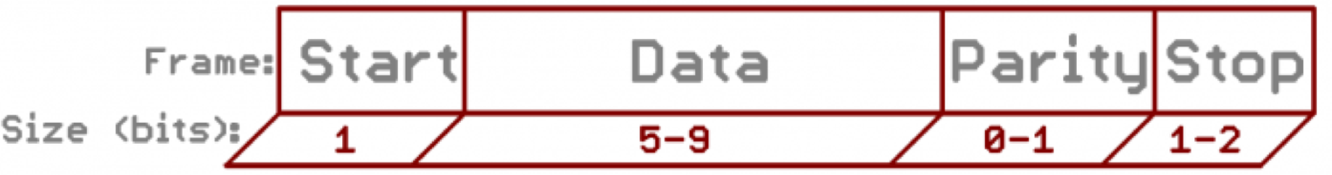
Communication Protocols
Timing in serial communication
Synchronous Serial
Asynchronous Serial
Rules of Asynch. Protocols
Synch bit
Parity bit
Baud rate
Data bit

Slide 41

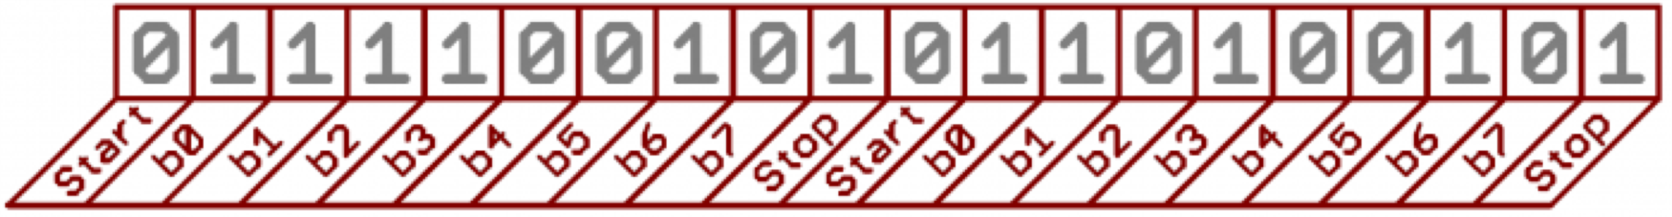
Parity and Baud Rate
Parity
– Even Parity : 10101010101 → 6 one’s → EP=0
– Odd Parity : 01010101010 → 5 one’s → OP=0
Baud Rate
Pulse per second
In digital world: Bits per second
9600 baud → 9600 bps or 104 µs per bit.
Synch bit
9600 8N1 – 9600 bps/
8 bits per data / No parity / One Stop bit Always has start bit
Required to define the beginning/end of the data
the start bit [LOW] and the stop bit [HIGH]

Slide 42
Questions
What will be the EVEN parity value if n=1111 1110?
What will be the ODD parity value if n=1111 1110?
How long does it take to transmit a 1-Mbit file at 9600 baud rate?
Let’s say P represents Even Parity. Assume P=1. Can we accept this as a correct frame: 1101 1110P?

Slide 43
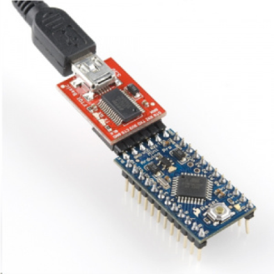
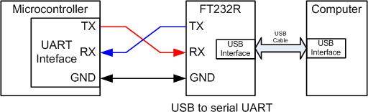
Serial Communication
Universal Asynchronous Receiver and Transmitter (UART)
UART is programmable.
Asynchronous
Sender provides no clock signal to receivers
FT232R converts the UART port to a standard USB interface

Slide 44
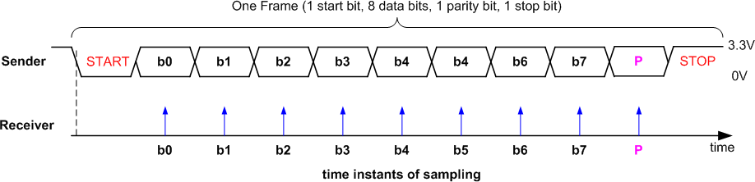
Data Frame
Tolerate 10% clock shift during transmission
Sender and receiver uses the same transmission speed
Data frame
Overhead % =
1 - (Useful Data / Total Data)
– One start bit
– Data (LSB first or MSB, and size of 7, 8, 9 bits)
Optional parity bit
One or two stop bit
9600/(1 + 8 + 1 + 1) = ~872 frames/second
7

Slide 45
Problem
Assume we have a file with size 1 million bits. Assume we use 9600:8-1-1 (includes STOP and SATRT bits). How long does it take to transmit the file? Calculate the Overhead %.
8-1-1→ each frame has 11 bits
Baud rate is 9600 bits/sec--> Frame rate = 9600/11=872.72 Frames/sec or 1.146 msec/frame
Number of frames generated: 1,000,000 bits x 1 frame/8 bit= 125,000 frames
Time to transmit 125,000 frames = 125000 frame x 1.146 msec/frame = 143.25 sec!
Overhead % = [1 - (Useful Data / Total Data)]x100 = [1 - (8/11)] x 100=27.3
How long does it take to transmit 100,000 bits at 57,600 baud rate?

Slide 46
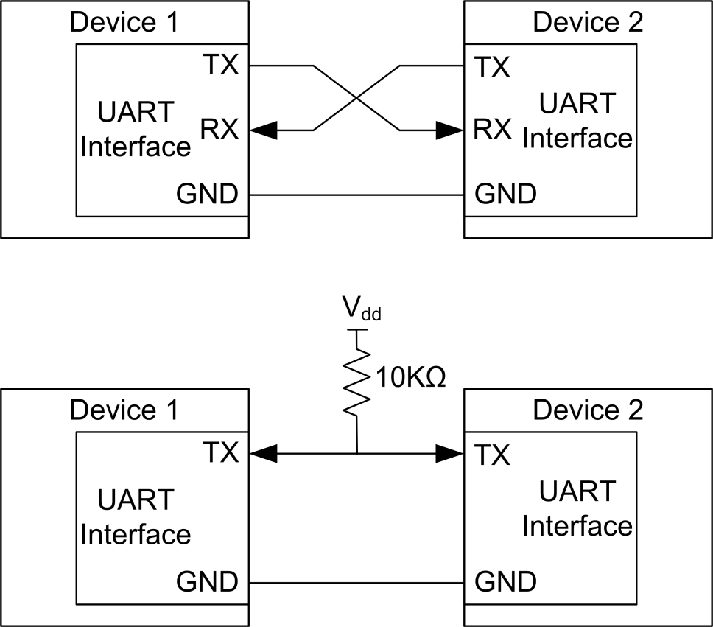
Communication Modes
A serial interface can have different communication modes
Full Duplex - means both devices can send and receive simultaneously.
Half-Duplex - means serial devices must take turns sending and receiving.

Slide 47
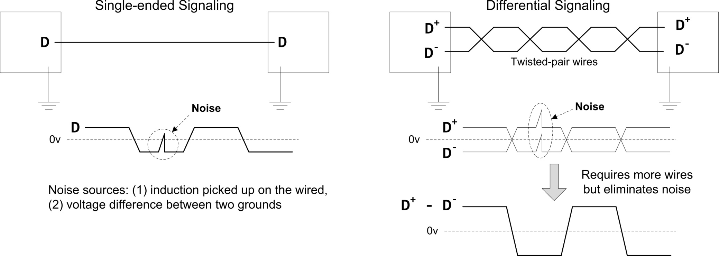

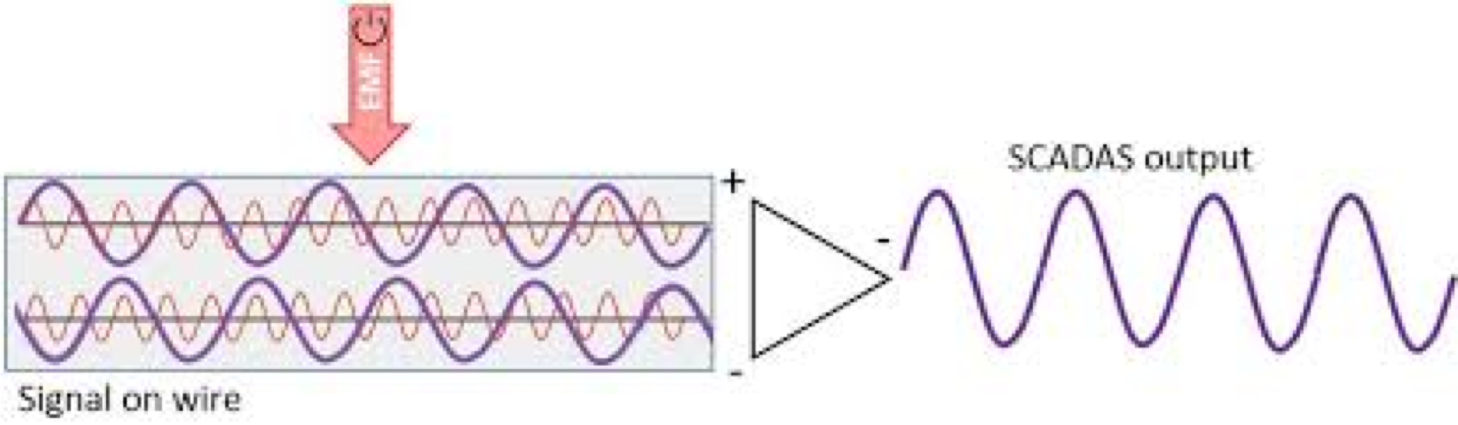


Differential Vs. Single Ended
Signal with less noise!

Slide 48
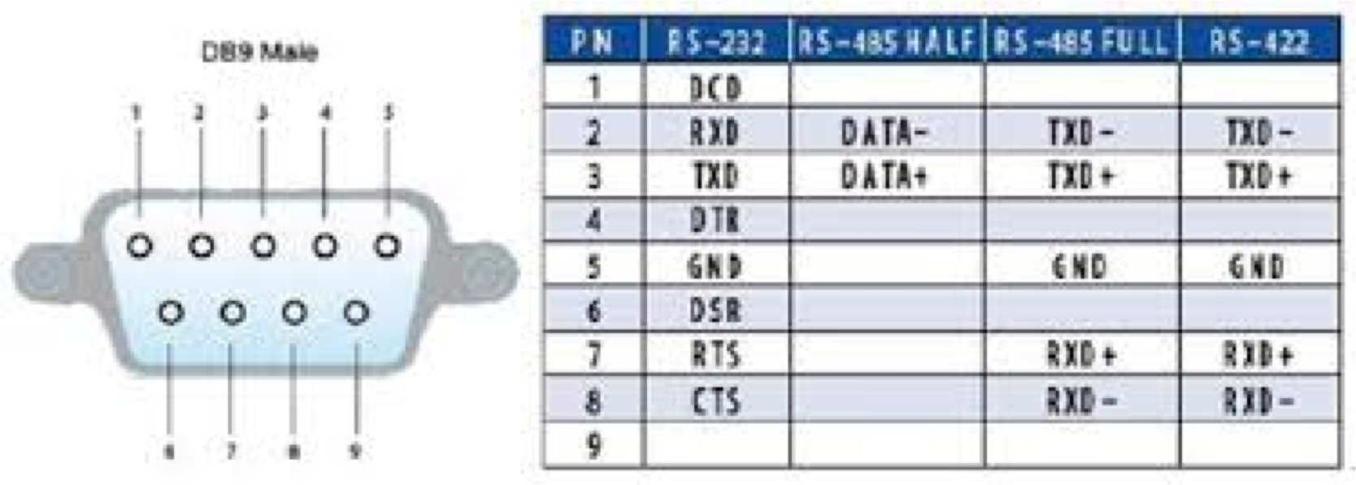
UART Protocols Different Voltage Levels
Standard | Voltage signal | Max distance | Max speed | Number of devices supported per port
RS-232 | Single end ( logic 1: +5 to +15V, logic 0: -5 to -15 V) | 100 feet | 115Kbit/s | 1 master, 1 receiver
RS-422 | Differential (-6V to +6V) | 4000 feet | 10Mbit/s | 1 master, 10 receivers
RS-485 | Differential (-7V to +12V) | 4000 feet | 10Mbit/s | 32 masters, 32 receivers

Slide 49
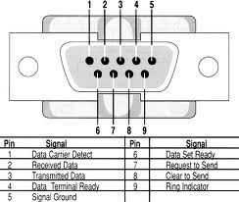
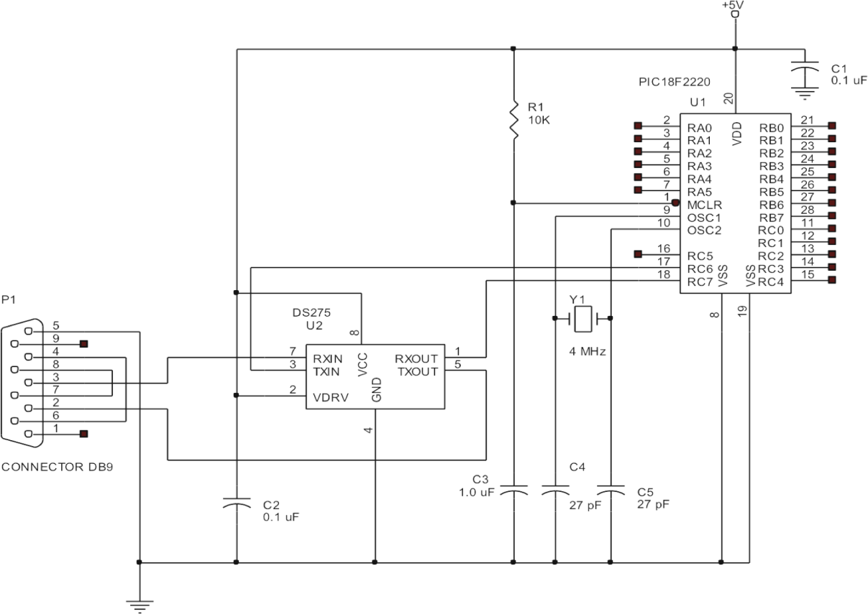
Interfacing
Note that in general we SHOULD use something like Maxim's MAX232 in order to ensure voltage compa)bility between the PIC and the RS232 or the terminal
It is also possible to INVERT polarity of the signals on TX and RX pins of USART, to interface to the terminal

Slide 50
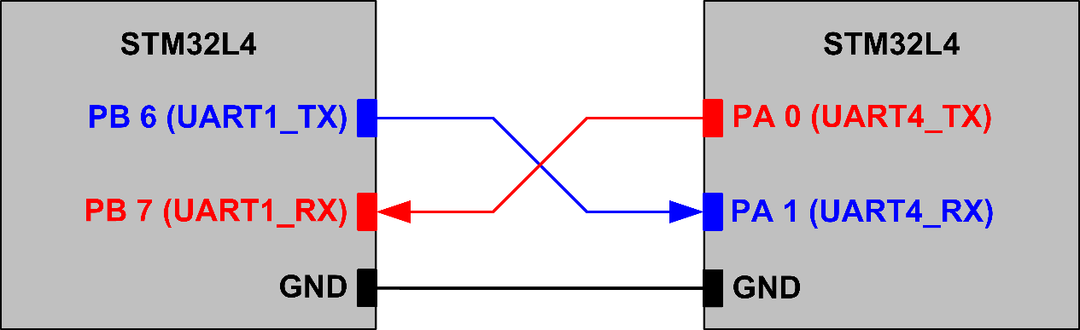





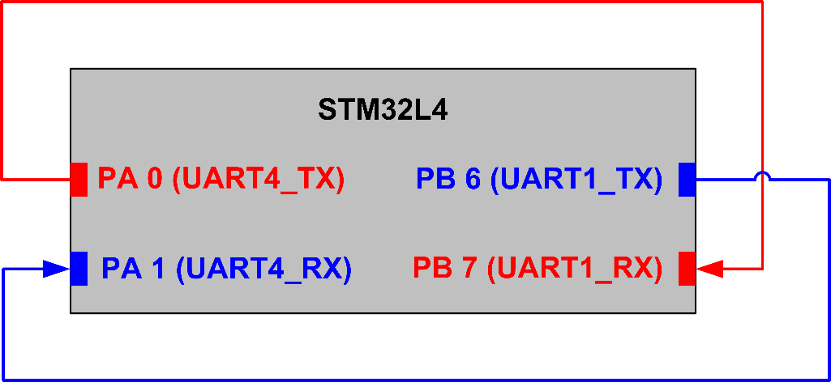


UART Connection
To send and receive data using UART we can use several methods including:
polling, interrupt
PIC
PIC
PIC
19

Slide 51
Clocks, Watchdog Timer / Timers

Slide 52
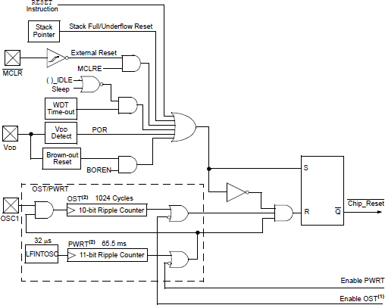
Reset Conditions
Master Clear
Initializes the MCU Starts with memory 0x00
RC time constant 10-20 msec (R=10K/C=1uF)
#pragma config MCLRE = ON
VCC
R1 R
MCLR SW
C1 C

Slide 53
Watchdog Timer
The watchdog timer is a device that resets the microcontroller if it is allowed to expire.
The watchdog timer is programmable to expire between 4 ms and 131 seconds.
The watchdog timer is restarted with a ClrWdt() function in C-Language to reset it so it does not expire and cause a reset.
C statement | Assembly Language | Scaling factor | Time to Reset
#pragma config WDTPS = 1 | _WDTPS_1_2H | 1:1 | 4 ms
#pragma config WDTPS = 32768 | _WDTPS_32768_2H | 1:32768 | 131.072 sec

Slide 54
Brownout Reset
The brownout reset is programmed and used to reset the microcontroller if the power supply voltage drops below a pre-programmed value.
The brownout reset triggers the microcontroller and waits at the reset state until the power supply voltage returns to a level higher then the programmed brownout voltage.
C language | Assembly Language | Brownout Voltage
#pragma config BORV = 45 | _BORV_45_2L | 4.5 V
#pragma config BORV = 42 | _BORV_42_2L | 4.2 V
#pragma config BORV = 27 | _BORV_27_2L | 2.7 V
#pragma config BORV = 20 | _BORV_20_2L | 2.0 V

Slide 55
Clocks
The PIC18 family allows many different clocking modes for operation. Some include internal timing and some external.
External timing sources are very accurate and are crystal- or resonator-based. A less accurate, but less expensive timing source is an RC circuit. An oscillator module or external timing signal can also be used for the microcontroller.

Slide 56
Clock Sources
□
□
□
□
□
□
□
□
□
□
1. Low power crystal (LP)
Examples of
External XTL or ceramic
2. Crystal or ceramic resonator (XT)
High-speed crystal or ceramic resonator (HS) ^{Resonator (OSC1/OSC2)}
High-speed crystal or ceramic resonator with PLL (HSPLL)
External resister/capacitor with Fosc/4 output on OSC2 (RC)
External resister/capacitor with I/O on OSC2 (RCIO)
*Internal oscillator with Fosc/4 on RA6 and I/O on RA7 (INTIO1)
*Internal oscillator with I/O on RA6 and RA7 (INTIO2)
External clock with Fosc/4 (EC)
External clock with I/O on RA6 (ECIO)
*some versions do not have an internal oscillator and
some versions may have additional modes

Slide 57
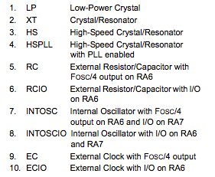
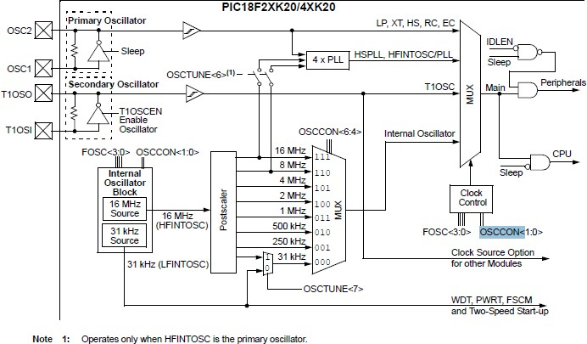
MCU Clock Source Diagram

Slide 58
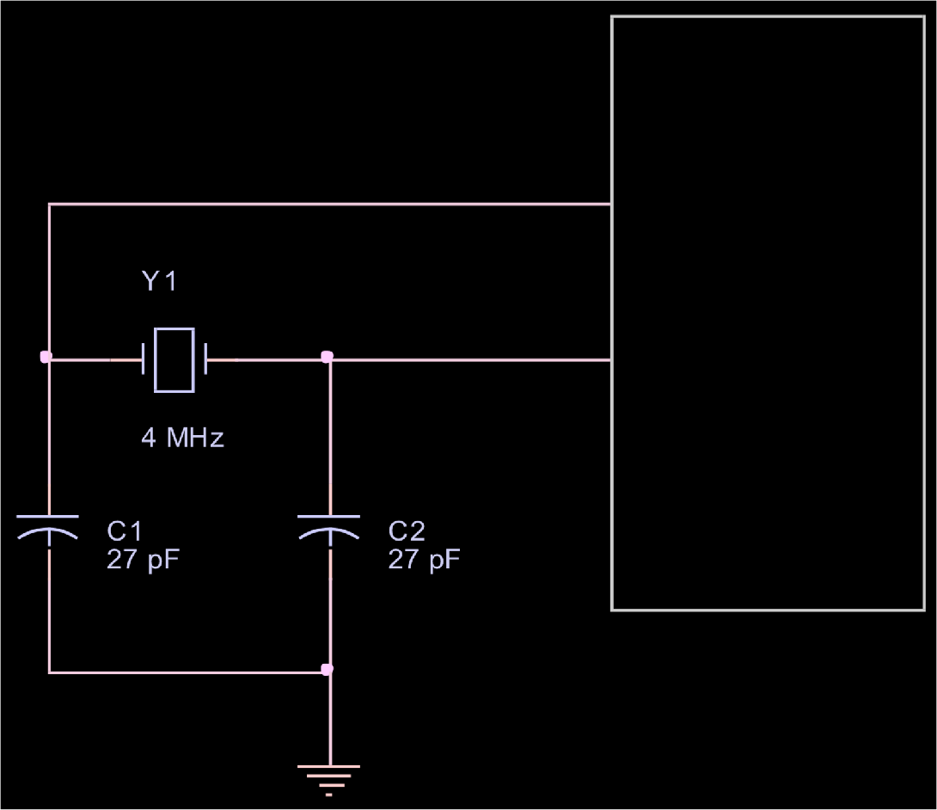
XTL / Ceramic
Clock Source Connection
PIC
PLL internal function Allows multiplying the External clock by 4;
This is used to reduce the EMI (Electromagnetic Interference) on the board
OSC1
OSC2

Slide 59
RC Oscillator
Clock Source Connection
OSC2 Fosc/4 OSC1
PIC
External Clock Input
OSC1
□External resister/capacitor with Fosc/4 output on OSC2 (RC) 2 MHz operation is attained with R = 3.9K
and C = 30 pF, Fosc/4 is 500 KHz with these values Frequency = 1/[RC(4.2)] ; can vary slightly
External clock source Connected to OSC1

Slide 60
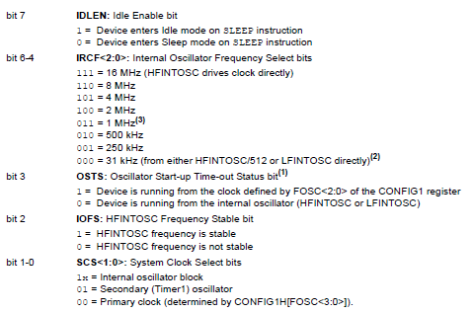
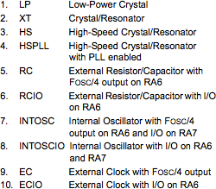
Clock Examples
#pragma config OSC = HS // high speed crystal oscillator
#pragma config OSC = RC // RC oscillator
#pragma config OSC = INTIO1 // internal oscillator
OSCCON Register

Slide 61
Programming Example
#pragma config MCLRE = ON #pragma config OSC = HS #pragma config WDT = ON #pragma config WDTPS = 256 #pragma config BORV = 42 #pragma BOR = ON
// enable master clear input
// select crystal oscillator
// set watchdog
// watchdog time is 1 second
// set brownout reset voltage
// brownout is on
void main(void)
// initialize system here
while ( 1 )
{
ClrWdt();
// main program loop
// reset watchdog
// system software goes here
}

Slide 62
Basic Concepts in Counters and Timers
In digital systems
Counting is a fundamental concept.
Clock is an essential element.
Count is in synchronization with the clock.
Count is converted in time by multiplying the count and the clock period.

Slide 63
Hardware Counters and Timers
Counter is a register that can be loaded with a binary number (count) which can be decremented or incremented per clock cycle.
Calculating time:
Find the difference between the beginning count and the last count
Multiply the count difference by the clock period
The register can also be used as a counter by replacing the clock with a signal from an event.
When a signal from an event arrives, the count in the register is incremented (or decremented); thus, the total number of events can be counted.

Slide 64
Types of Counters
Up-counter
Counter is incremented at every clock cycle
When count reaches the maximum count, a flag is set
Counter can be reset to zero or to the initial value
Down-counter
Counter is decremented at every clock cycle
When count reaches zero, a flag is set
Counter can be reset to the maximum or the initial value
Free-running counter
Counter runs continuously and only readable
When it reaches the maximum count, a flag is set
What are applications on timers?

Slide 65
Timer Applications
Time delay
Pulse wave generation
Pulse width or frequency measurement
Timer as an event counter

Slide 66
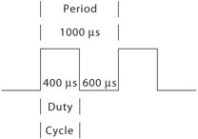
Capture, Compare, and PWM (CCP) Modules
CCP modules are commonly found in recent microcontrollers
16-bit (or two 8-bit) registers specially designed to perform the following functions in conjunction with timers
Capture: The CCP pin can be set as an input to record the arrival time of a pulse.
Compare: The CCP pin is set as an output, and at a given count, it can be driven low, high, or toggled.
Pulse width modulation (PWM): The CCP pin is set as an output and the duty cycle of a pulse can be varied.
The count for the period and the duty cycle are loaded into CCP registers.
In this mode, the duty cycle of the output pulse can be varied.

Slide 67
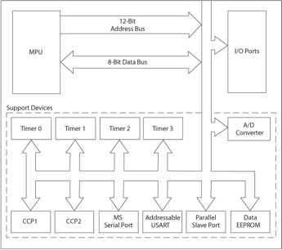

Same for:

Slide 68

PIC18 Timers
The PIC18 microcontroller have multiple timers, and all of them are up-counters.
Timers are divided into two groups: 8-bit and 16-bit
Labeled as Timer0 to Timer3 or Timer4 (if available)
Timer0 can be set up as an 8-bit or 16-bit timer.
Timer1 and Timer3 are 16-bit timers.
Timer2 and Timer4 (if available) are 8-bit timers.
Each timer associated with its Special Function Register (SFR): T0CON-T3CON or T4CON

Slide 69



Timer0
Note: TMR Flags are set when the counter reg. has reached it max.
Timer0 8- bit
Timer0 Control Register (T0CON)
Can be set up as an 8-bit or 16-bit timer
Has eight options of pre-scale values (Divides)
Can run on internal clock source (instruction
cycle) or external clock connected to pin RA4/T0CK1
Generates an interrupt or sets a flag when it
overflows from FFH to 00 in the 8-bit mode and from FFFFH to 0000 in the 16-bit mode
Can be set up on either rising edge or falling edge when an external clock is used
Timer0 16-bit
Instruction cycle = 4 clock cycle

Slide 70
Timer0
Timer0 8- bit
Timer0 Control Register (T0CON)
Can be set up as an 8-bit or 16-bit timer
Has eight options of pre-scale values (Divides)
Can run on internal clock source (instruction
cycle) or external clock connected to pin RA4/T0CK1
Generates an interrupt or sets a flag when it
overflows from FFH to 00 in the 8-bit mode and from FFFFH to 0000 in the 16-bit mode
Can be set up on either rising edge or falling edge when an external clock is used
Timer0 16-bit
Instruction cycle = 4 clock cycle

Slide 71

TIMER0 Registers

Slide 72
Timer0
TMROH buffer between internal data bus and TMR0 high byte
Read from the TMR0L register, the upper half of Timer0 is latched into the TMR0H register
Ensures that the PIC18 always reads a 16-bit value that its upper byte and lower byte belong to the same time (since only read 8-bits at a time)

Slide 73

Timer0 Control Register (1 of 2)
□ Timer0 as timer
■
Bit5 must be cleared to use the internal clock.
At each instruction cycle (four clock cycles), the timer register is incremented.
■
□ Timer0 as a counter
■
■
Bit5 must be set 1 to use an external clock.
In this mode, input signal at PORTA-pin RA4/T0CK used as a clock.
When Bit4 = 1, register is incremented on the falling edge, and when Bit4 = 0, the register is incremented on the rising edge.
■
□ Prescaler
■
■
Divides clock frequency by a specified ratio.
To use prescaler, Bit3 = 0, and three bits Bit2-Bit0 specify scaler ratio from 1:2 to 1:256

Slide 74
Timer0 Control Register (2 of 2)
Interrupt
When Timer0 overflows from FFH to 00 in the 8-bit mode and from FFFFH to 0000 in the16-bit mode, it sets TMR0IF (Timer0 Interrupt Flag) –Bit2 in the INTCON register.
□
Flag can be used two ways: 1) a software loop can be set up to monitor the flag, or 2) an interrupt can be generated.
Flag must be cleared to start the timer again.
□
16-bit mode
When Timer0 is set in the 16-bit mode, it uses two 8-bit registers TMR0L and TMR0H.

Slide 75

Control Word to Initialize Timer0

Slide 76
Example - Set TMR0 as an 8-bit timer
Every instruction cycle the register is updated → 4x(Clock_Period)
With a pre-scale=1:256 (divide the clock by 256)→  pre_scalex4x(Clock_Period)
8-bit register allows counting 256 values →
(2^n)x pre_scalex4x(Clock_Period)
Assuming using a 10MHz internal clock, rising edge clock, how often the flag is set if timer 0 is set as 8-bit counter? What should TMR0 (T0CON ) setup be?
256x256x4x0.1E-6=Every 26.21 msec
1
1
0
0
0
1
1
1

Slide 77



Timer1 – 16-bit (1 of 5)
A 16-bit counter/timer with two 8-bit registers (TMR1H and TMR1L); both registers are readable and writable
Four options of prescale value (Bit5-Bit4)
Clock source (Bit1) can be internal (instruction cycle) or external (pin RC0/T13CK1) on rising edge
Sets flag or generates an interrupt when it overflows from FFFFH to 0000
Used to synch with the rising edge of the external clock

Slide 78


Timer1 (3 of 5)
Timer1 Operation
Can operate in three modes:
timer,
synchronous counter,
asynchronous counter
Bit0 enables or disables the timer
When Bit1 = 0, it operates as a timer and increments count at every instruction cycle.
When Bit1 = 1, it operates as a counter and increments count at every rising edge of the external clock.
When Bit3 = 1, Timer1 oscillator is enabled which is used for low frequency operations.

Slide 79


Timer2
Two 8-bit registers (TMR2 and PR2)
An 8-bit number is loaded in PR2 and the timer is turned on, which is incremented every instruction cycle.
When the count in the timer register and the PR register match, an output pulse is generated and the timer register is set to zero.
The output pulse goes through a postscaler that divides the frequency by the scale factor and sets the flag TMR2IF-
Freq. Clk
Pulse
Master Synchronous Serial Port (MSSP)
Bit1 in the Peripheral Interrupt Register1 (PIR1) that can be used to generate an interrupt.

Slide 80
Example for Timer2
□ Generate a periodic high-priority interrupt every 8-msec using Timer2. Assume a 32-MHz crystal oscillator.
Assume post/pre scaled values are 16
Loaded value in PR2 will be
Remember, we start
with 0 count → -1 is needed
□
PR2 = [Td / [Inst. Clock Cycle(4) x Prescaler x PostScaler x clock period)]] - 1 PR2 = [ 8msec/[4x16x16x(1/32MHZ)] ] -1 =249
□
PR2=249 RCON: IPEN=1
IPR1: TMR21P=1; TMR2IF=CLR INTCON=C0; GLOBAL INT
T2CON=7E; TMR2 ENABLE AND SCALING SETUP PIE1: TMR2IE=SET
TMR2
Comp
PR2

Slide 81

Example for Timer2 - continue
□ Actual code:
PR2=249 RCON: IPEN=1
IPR1: TMR21P=1; TMR2IF=CLR INTCON=C0; GLOBAL INT
T2CON=7E; TMR2 ENABLE AND SCALING SETUP PIE1: TMR2IE=SET

Slide 82


Timer3
□ Similar to Timer1

Slide 83

Timer4
Only available to the PIC18F8X2X and PIC6X2X devices
The value of TMR4 is compared to PR4 in each clock cycle
When the value of TMR4 equals that of PR4, TMR4 is reset to 0
The contents of T4CON are identical to those of T2CON
….similar to Timer2 (Two 8-bit registers )

